Slide 1
DV1C04 Deployment and Monitoring in DevOps
L10
Puppet in Jenkins Pipleine

Slide 2
Learning Objectives
Integrate Puppet with Jenkins Pipeline

Slide 3
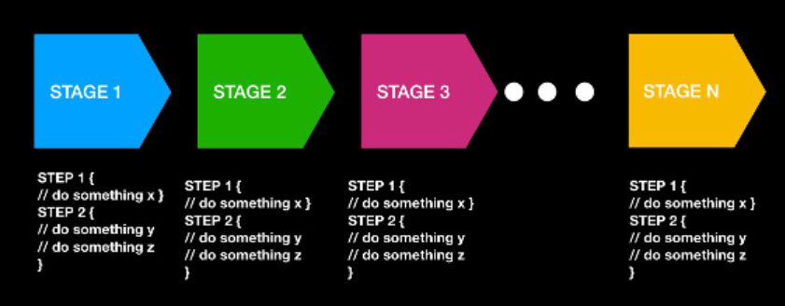
Recap on Jenkins Pipeline
A pipeline is a sequence of events or jobs that can be executed.
Picture Ref: https://opensource.com/article/19/9/intro-building-cicd-pipelines-jenkins

Slide 4
Purpose of Integration
IT resources are supporting business strategies in company. As market windows has become smaller, the cycle of a software or application from development to production has to be faster. Manual operations would not be able to keep with the pace. The software cycle has to be relooked at. The whole pipeline has to be automated as much as possible. Although speed is important, security and reliability of a software product is as important.
Ref:https://phoenixnap.com/blog/devops-pipeline
Notes:
A job is a series of steps that run sequentially as a unit. In other words, a job is the smallest unit of work that can be scheduled to run.
A task is the building block for defining automation in a pipeline. A task is simply a packaged script or procedure that has been abstracted with a set of inputs.

Slide 5
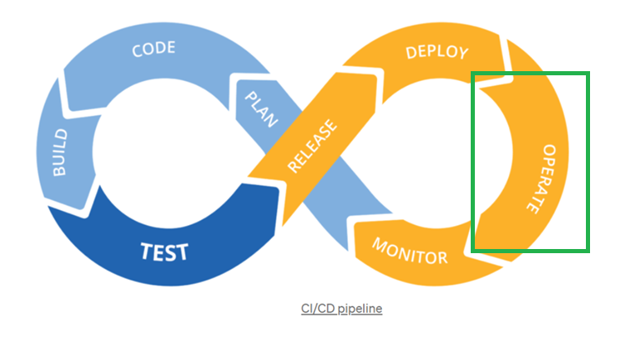
Operate Phase
Ref: https://towardsdatascience.com/ci-cd-pipeline-with-azure-devops-for-data-science-project-f263586c266e

Slide 6
Example of an Integration
Scenario:
A web page needs to be updated
Code has been developed and is ready to be rolled out
Git is used for concentralised respository
Jenkins is used as the pipeline for rolling out the page
Puppet is used for updating the web page to a development container, and subsequently to a production environment
Notes:
A job is a series of steps that run sequentially as a unit. In other words, a job is the smallest unit of work that can be scheduled to run.
A task is the building block for defining automation in a pipeline. A task is simply a packaged script or procedure that has been abstracted with a set of inputs.

Slide 7
Recap Jenkinsfile
A Jenkinsfile is a text file that contains the definition of a Jenkins Pipeline. It controls the stages and steps of the jenkine pipeline.
Notes:
A job is a series of steps that run sequentially as a unit. In other words, a job is the smallest unit of work that can be scheduled to run.
A task is the building block for defining automation in a pipeline. A task is simply a packaged script or procedure that has been abstracted with a set of inputs.

Slide 8
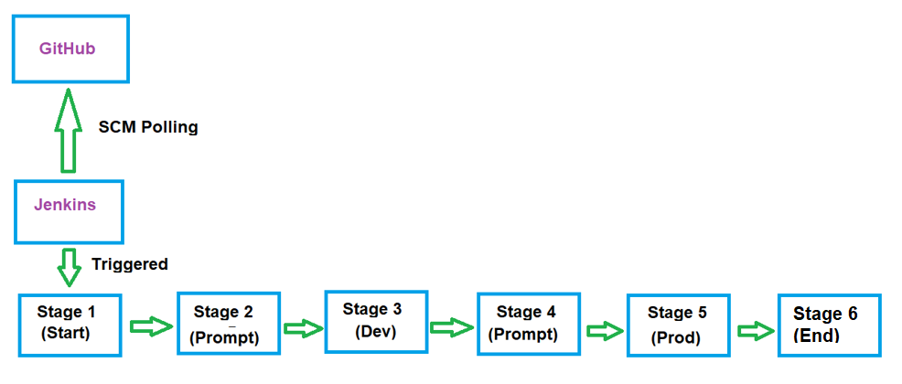
Overview of Jenkins Pipeline

Slide 9
Local Git Repository
Create a directory for local Git Repository. In case, the directory is /devops_repo . The local repository has 3 files:
index.html – file to be updated to apache server
Jenkinsfile – File which describes and control the pipeline
script_to_run – script that performs the required tasks

Slide 10
Overview of Jenkins Pipeline
Perform the stage to update the local repository to the remote repository:

Slide 11
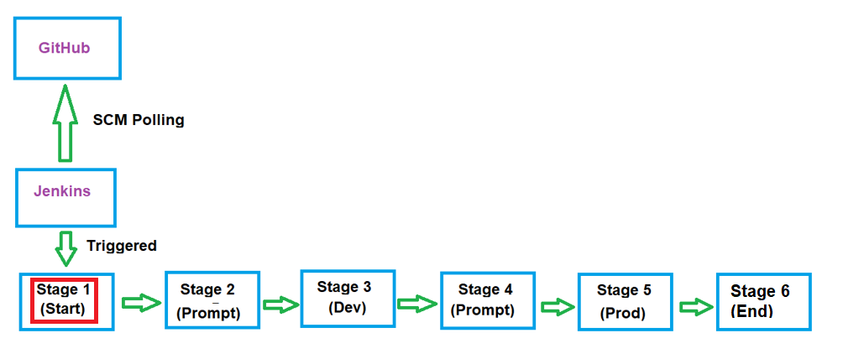
Jenkinsfile
pipeline {
agent any
stages {
stage('One') {
steps {
echo 'Begin of Pipeline: Stage one completes'
}
}
Notes:
A job is a series of steps that run sequentially as a unit. In other words, a job is the smallest unit of work that can be scheduled to run.
A task is the building block for defining automation in a pipeline. A task is simply a packaged script or procedure that has been abstracted with a set of inputs.

Slide 12
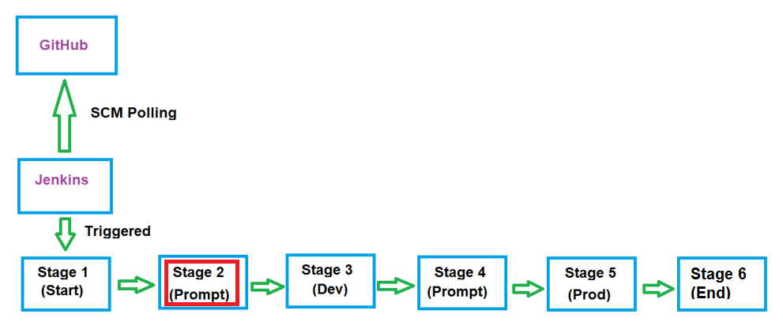
Jenkinsfile
stage('Two') {
steps {
input('Do you want to update to Development container?')
}
}
Notes:
A job is a series of steps that run sequentially as a unit. In other words, a job is the smallest unit of work that can be scheduled to run.
A task is the building block for defining automation in a pipeline. A task is simply a packaged script or procedure that has been abstracted with a set of inputs.

Slide 13
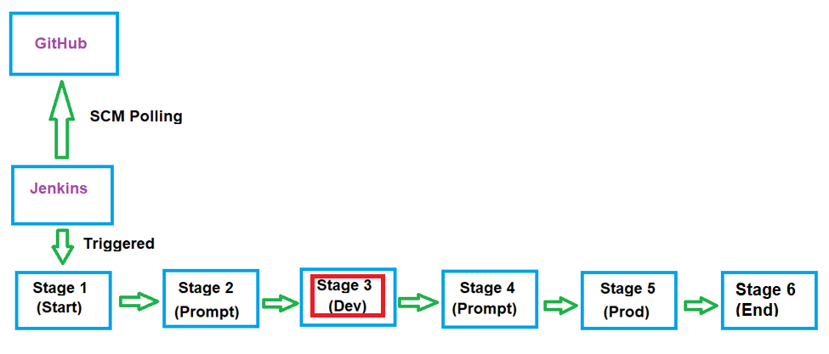
Jenkinsfile
stage('Three') {
when {
not {
branch "Development NOT updated"
}
}
steps {
sh '''#!/bin/bash
targets=puppetclient1;
locate_script='/testdir/work/devops_repo/script_to_run';
docker cp $locate_script $targets://$locate_script;
bolt script run $locate_script -t $targets -u clientadm -p user123 --no-host-key-check --run-as root;
'''
echo "Development container updated"
}
}
Notes:
A job is a series of steps that run sequentially as a unit. In other words, a job is the smallest unit of work that can be scheduled to run.
A task is the building block for defining automation in a pipeline. A task is simply a packaged script or procedure that has been abstracted with a set of inputs.

Slide 14
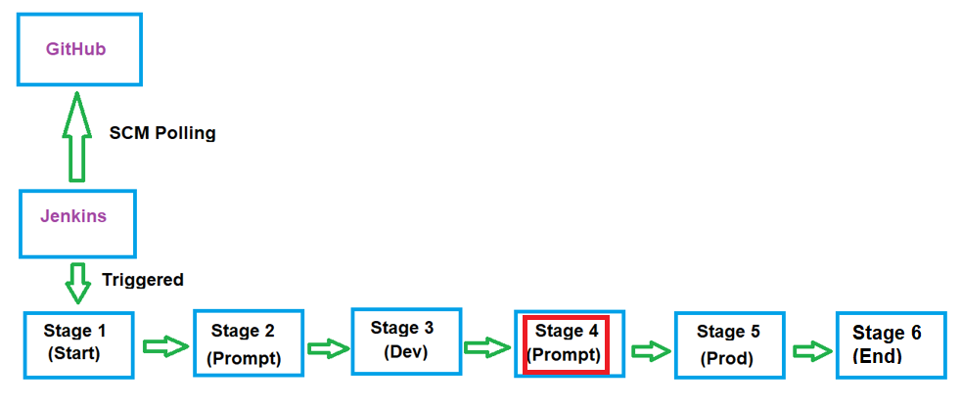
Jenkinsfile
stage('Four') {
steps {
input('Do you want to update to Production container: Proceed to Production')
}
}
Notes:
A job is a series of steps that run sequentially as a unit. In other words, a job is the smallest unit of work that can be scheduled to run.
A task is the building block for defining automation in a pipeline. A task is simply a packaged script or procedure that has been abstracted with a set of inputs.

Slide 15
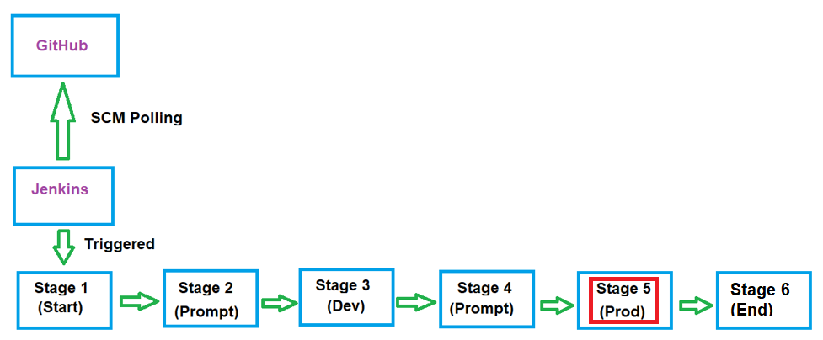
Jenkinsfile
stage('Five') {
when {
not {
branch "Production NOT updated"
}
}
steps {
sh '''#!/bin/bash
targets=puppetclient2;
locate_script='/testdir/work/devops_repo/script_to_run';
docker cp $locate_script $targets://$locate_script;
bolt script run $locate_script -t $targets -u clientadm -p user123 --no-host-key-check --run-as root;
'''
echo "Production container updated"
}
}
Notes:
A job is a series of steps that run sequentially as a unit. In other words, a job is the smallest unit of work that can be scheduled to run.
A task is the building block for defining automation in a pipeline. A task is simply a packaged script or procedure that has been abstracted with a set of inputs.

Slide 16
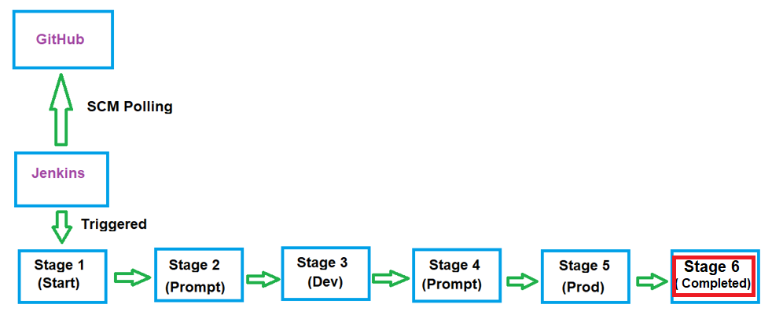
Jenkinsfile
stage('Completed updating Operation') {
steps {
echo 'Completed updating to Production Container'
}
}
}
}
Notes:
A job is a series of steps that run sequentially as a unit. In other words, a job is the smallest unit of work that can be scheduled to run.
A task is the building block for defining automation in a pipeline. A task is simply a packaged script or procedure that has been abstracted with a set of inputs.

Slide 17
Content of the html page
The html page to be updated is index.html. The file is located at /var/www/html directory.
Index.html’s content
<html>
<head>
</head>
<body>
<h1>Hello World<h1>
</body>
</html>

Slide 18
Content of the Script
The script to be executed is script_to_run. This script is created and placed in /testdir/working/devops directory on puppet master server sddo-vm .
script_to_run’s content
#!/bin/bash
puppet resource package git ensure=present
puppet resource package apache2 ensure=present
puppet resource service apache2 ensure=running
puppet module install puppetlabs-vcsrepo
puppet resource file /testdir/clone ensure=absent force=true
puppet resource file /testdir ensure=directory
puppet resource file /testdir/clone ensure=directory
cd /testdir/clone
git clone https://<your github access key token>@github.com/<your github account name>/devops_repo.git
cp -p /testdir/clone/devops-repo/index.html /var/www/html

Slide 19
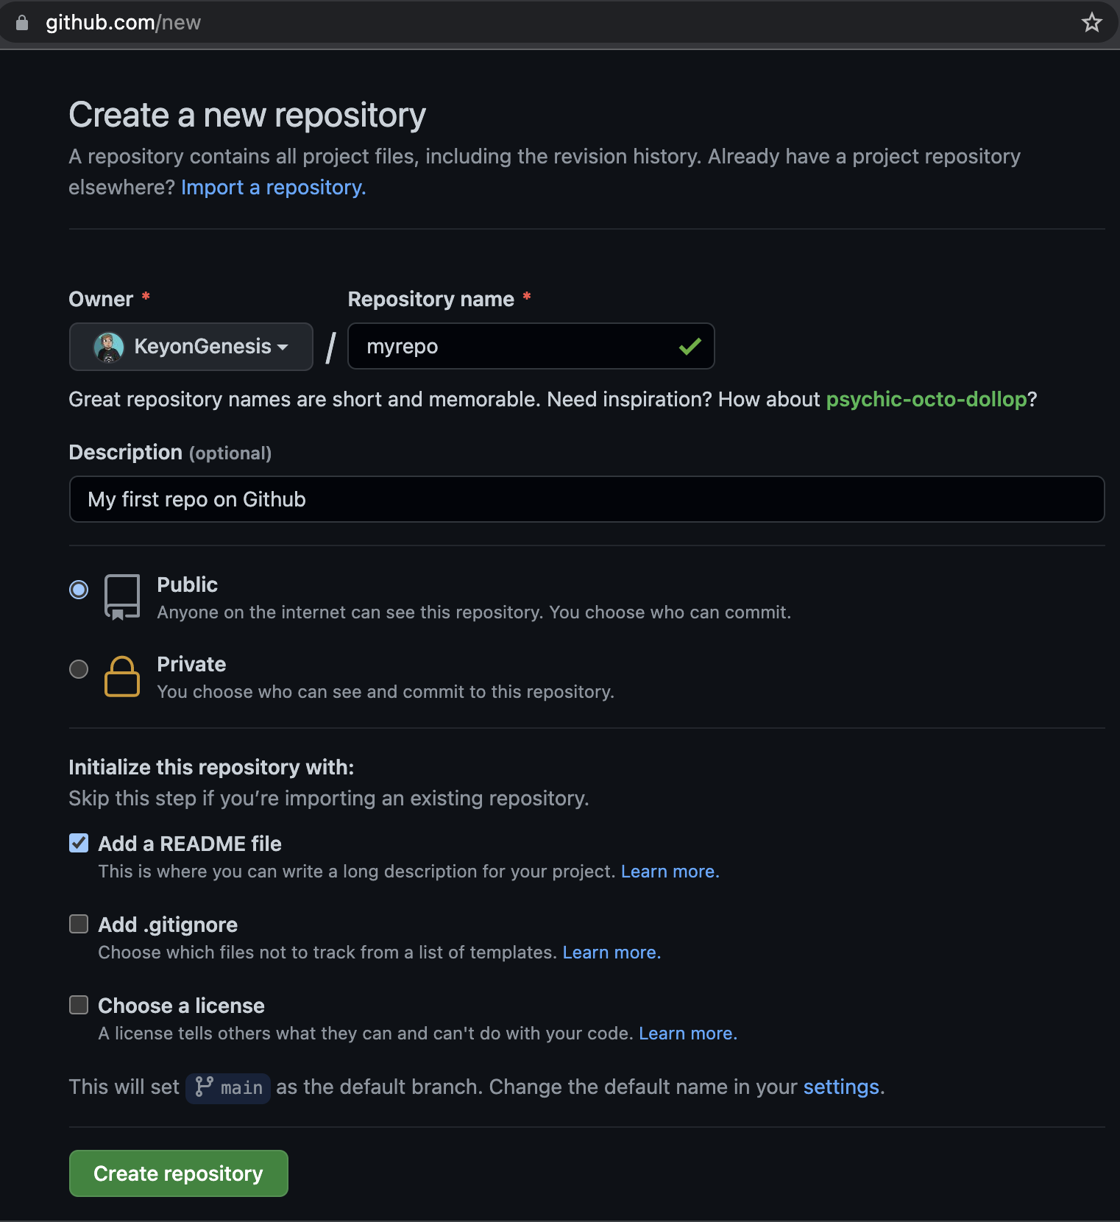
Setup GitHub Repository
Github repository centralises the storage of files. Jenkins file is one of the files stored in the repository.
Setup a new repository:

Slide 20
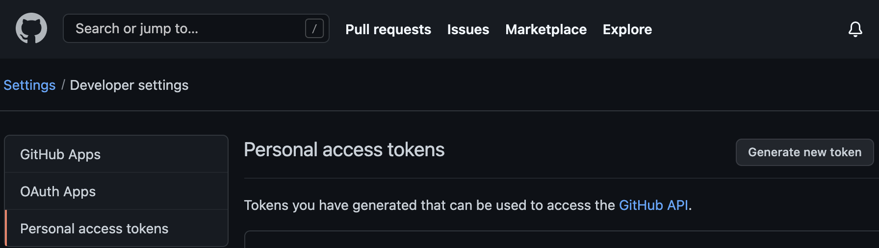
Github Access
Github now uses personal token.

Slide 21
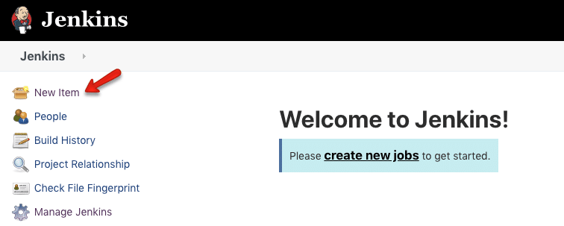
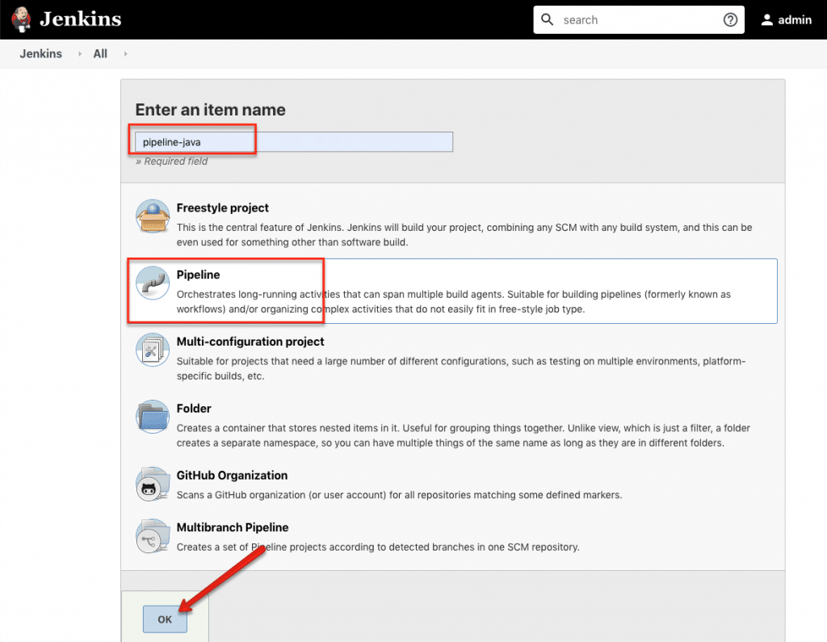
Setup Jenkins Pipeline
Create new Jenkins Pipeline.

Slide 22
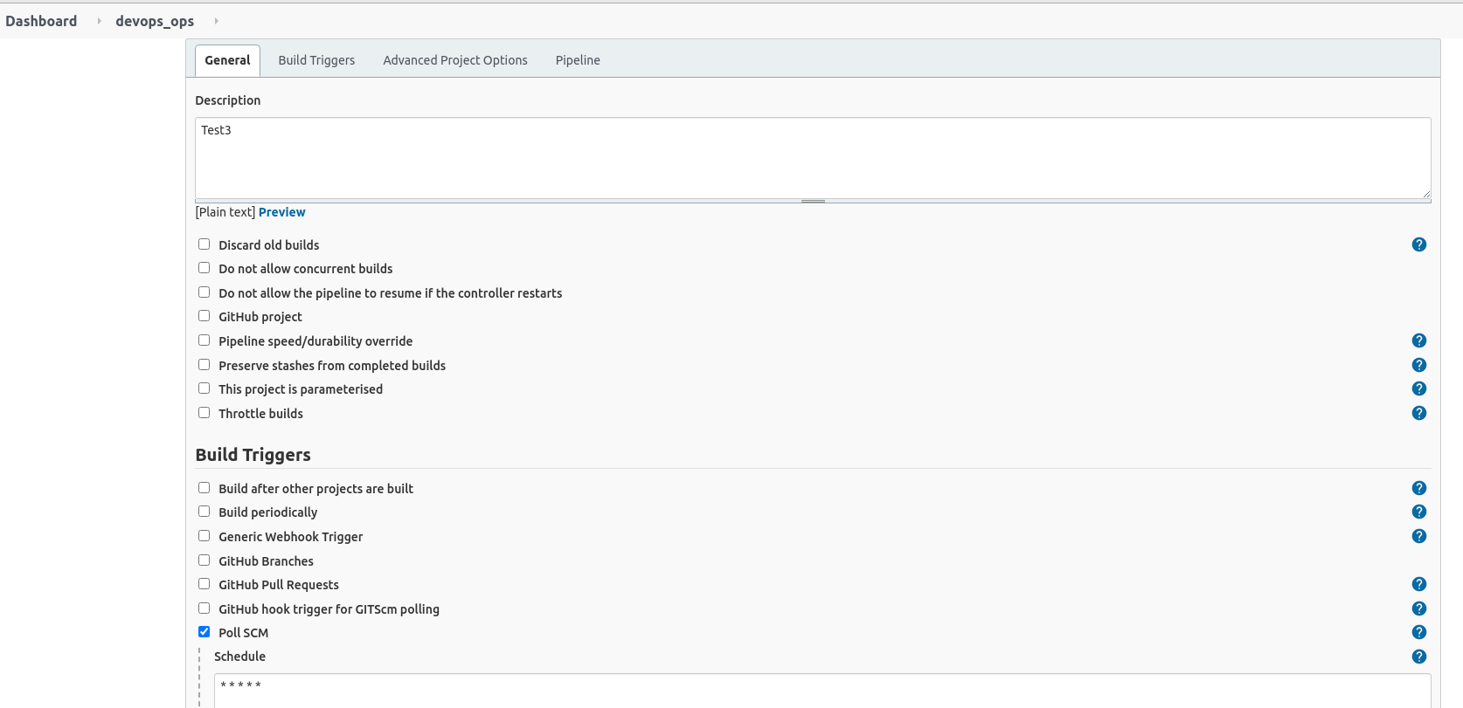
Configure Jenkins Pipeline
Configure Jenkins Pipeline to use Poll SCM.

Slide 23
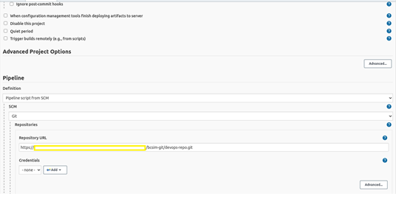
Configure Use of Access Token
Access key is use for accessing Github.

Slide 24
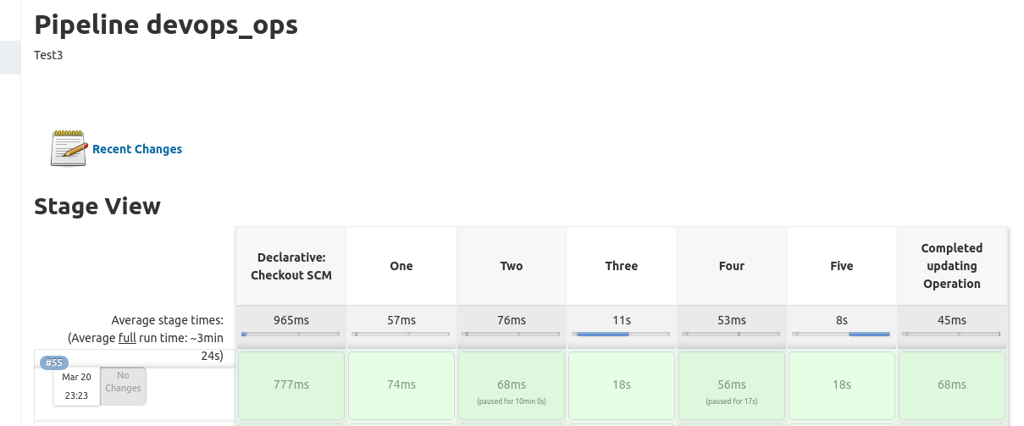
Completion of Pipeline Execution
The pipeline should complete its execution without error.

Slide 25
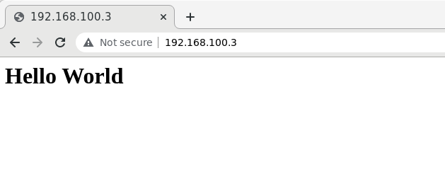
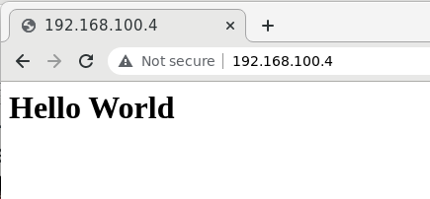
Test the pipeline
Test the pipeline to ensure it performs it tasks. For this scenario, the index file of website should be updated for 2 puppet node. The test is done via web browser on sddo-vm.
For puppetclient1:
For puppetclient2:

Slide 26
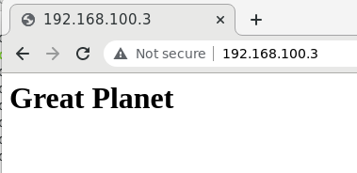
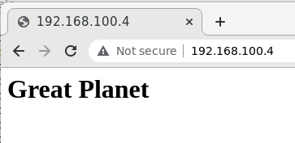
Test the pipeline
Edit the index file on sddo-vm, update to Github reporsitory, and then trigger Jenkins Pipeline. The websites’ index file are updated with new content.
For puppetclient1:
For puppetclient2:

Slide 27
Thank you

